Slide 1
Machine Learning – Clustering Algorithms
Basic definitions and plot diagrams

Slide 2
1. K-means Clustering
K means clustering, assigns data points to one of the K clusters depending on their distance from the center of the clusters. It starts by randomly assigning the clusters centroid in the space. Then each data point assign to one of the cluster based on its distance from centroid of the cluster. After assigning each point to one of the cluster, new cluster centroids are assigned.
This process runs iteratively until it finds good cluster. In the analysis we assume that number of cluster is given in advanced and we have to put points in one of the group. Merits :
K Means is faster as compare to other clustering technique.
It provides strong coupling between the data points. Demerits :
K Means clustering performs best data is well separated. When data points overlapped this clustering is not suitable.
K Means cluster do not provide clear information regarding the quality of clusters.

Slide 3
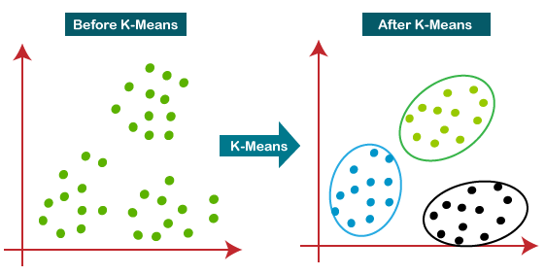
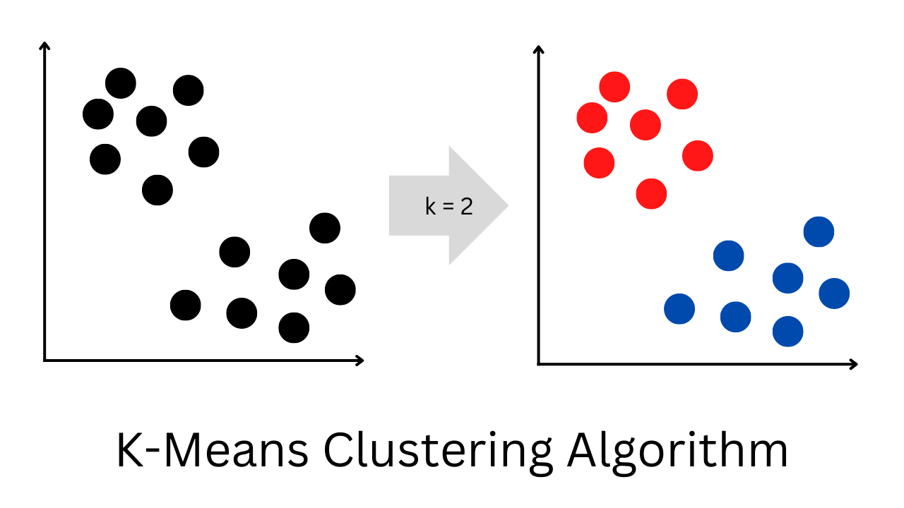

Slide 4
2.Agglomerative Clustering
Hierarchical clustering is a connectivity-based clustering model that groups the data points together that are close to each other based on the measure of similarity or distance. The assumption is that data points that are close to each other are more similar or related than data points that are farther apart.
A dendrogram, a tree-like figure produced by hierarchical clustering, depicts the hierarchical relationships between groups. Individual data points are located at the bottom of the dendrogram, while the largest clusters, which include all the data points, are located at the top. In order to generate different numbers of clusters, the dendrogram can be sliced at various heights
The dendrogram is created by iteratively merging or splitting clusters based on a measure of similarity or distance between data points(should be minimum) . Clusters are divided or merged repeatedly until all data points are contained within a single cluster.
It is also known as the bottom-up approach or hierarchical agglomerative clustering (HAC). Merits :
This clustering algorithm does not require us to prespecify the number of clusters. Bottom-up algorithms treat each data as a singleton cluster at the outset and then successively agglomerate pairs of clusters until all clusters have been merged into a single cluster that contains all data. Demerits:
It can be computationally expensive, it does not produce the same number of clusters for different datasets, it can struggle with high-dimensional data.

Slide 5
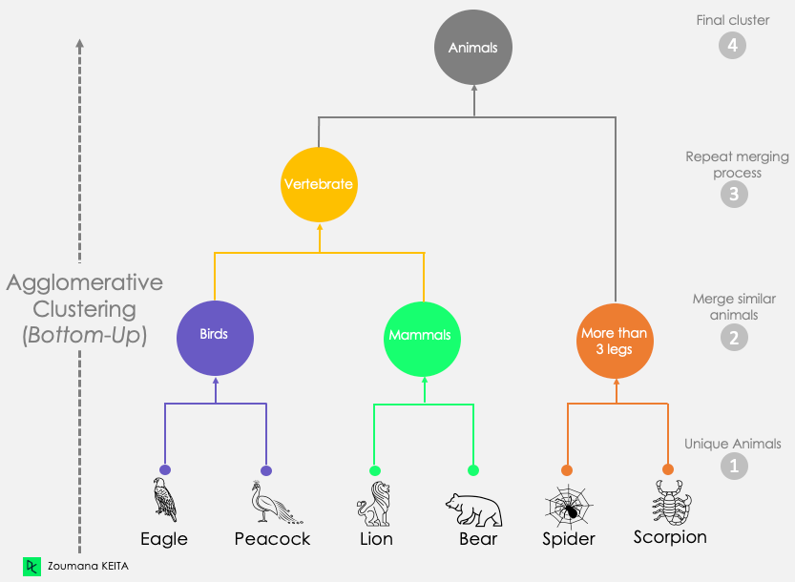
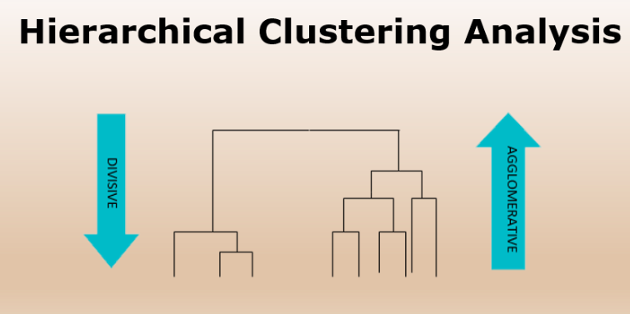
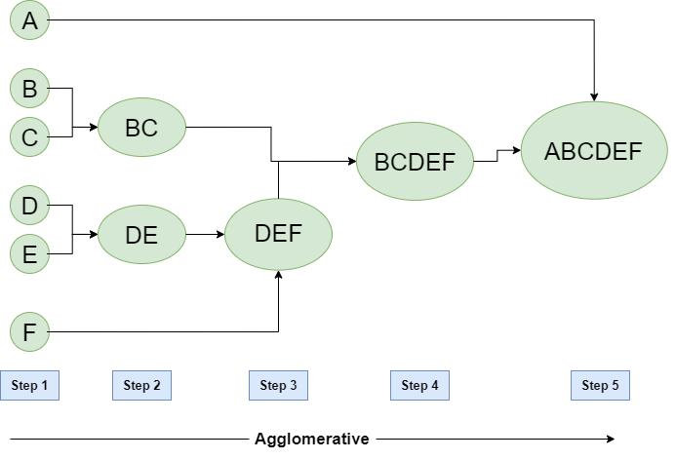
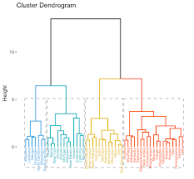

Slide 6
3.Bisecting K-means Algorithm
Bisecting K-Means Algorithm is a modification of the K-Means algorithm. It is a hybrid approach between partitional and hierarchical clustering. It can recognize clusters of any shape and size. Overcoming K-Means limitations:
It only identifies spherical-shaped clusters i.e it cannot identify, if the clusters are non-spherical or of various sizes and densities.
It suffers from local minima and has a problem when the data contains outliers. Merits:
It beats K-Means in entropy measurement.
When K is big, bisecting k-means is more effective. Every data point in the data collection and k centroids are used in the K-means method for computation. As a result, computation time is shortened.
While k-means is known to yield clusters of varied sizes, bisecting k-means results in clusters of comparable sizes.

Slide 7
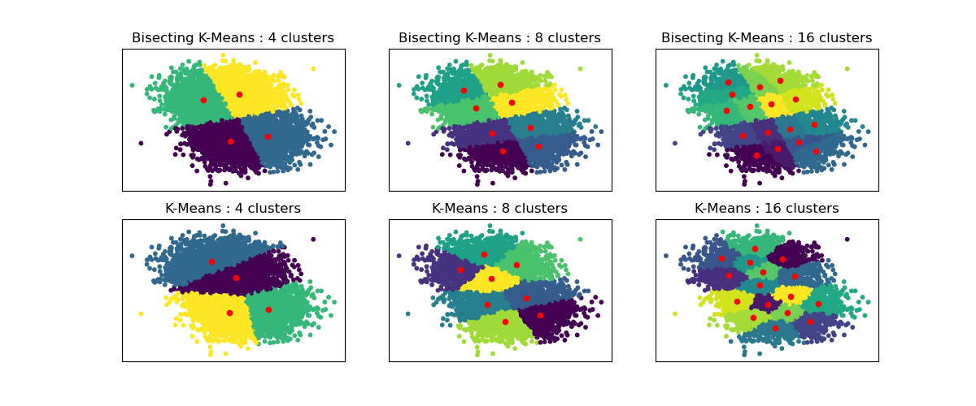
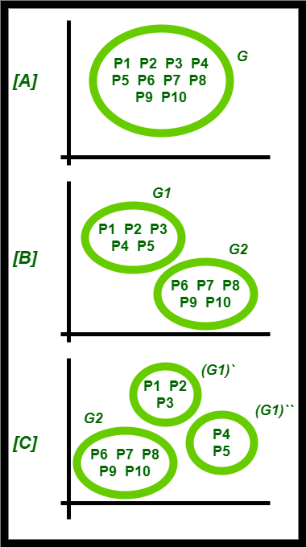
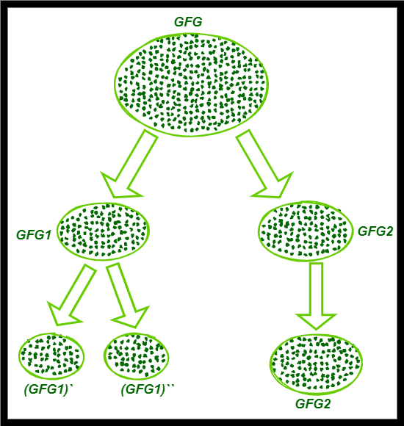

Slide 8
4.Mean shift Clustering
Meanshift is falling under the category of a clustering algorithm in contrast of Unsupervised learning that assigns the data points to the clusters iteratively by shifting points towards the mode (mode is the highest density of data points in the region, in the context of the Meanshift). As such, it is also known as the Mode-seeking algorithm. Mean-shift algorithm has applications in the field of image processing and computer vision.
Given a set of data points, the algorithm iteratively assigns each data point towards the closest cluster centroid and direction to the closest cluster centroid is determined by where most of the points nearby are at. So each iteration each data point will move closer to where the most points are at, which is or will lead to the cluster center. When the algorithm stops, each point is assigned to a cluster. Merits:
Mean-shift clustering is a non-parametric, density-based clustering algorithm that can be used to identify clusters in a dataset. It is particularly useful for datasets where the clusters have arbitrary shapes and are not well-separated by linear boundaries.
mean-shift does not require specifying the number of clusters in advance. The number of clusters is determined by the algorithm with respect to the data. Demerits:
Computationally expensive.

Slide 9
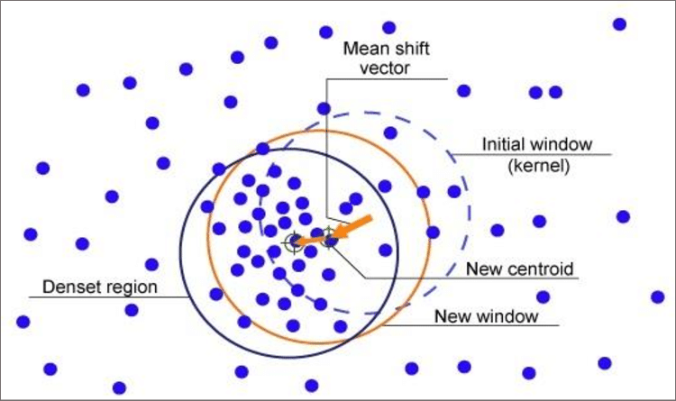
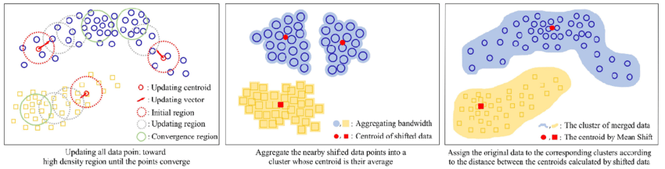

Slide 10
5.BIRCH
Balanced Iterative Reducing and Clustering using Hierarchies (BIRCH) is a clustering algorithm that can cluster large datasets by first generating a small and compact summary of the large dataset that retains as much information as possible. This smaller summary is then clustered instead of clustering the larger dataset. BIRCH is often used to complement other clustering algorithms by creating a summary of the dataset that the other clustering algorithm can now. Merits:
Clustering algorithms like K-means clustering do not perform clustering very efficiently and it is difficult to process large datasets with a limited amount of resources (like memory or a slower CPU). So, regular clustering algorithms do not scale well in terms of running time and quality as the size of the dataset increases. This is where BIRCH clustering comes in. Demerits:
It can only process metric attributes. A metric attribute is any attribute whose values can be represented in Euclidean space i.e., no categorical attributes should be present.

Slide 11
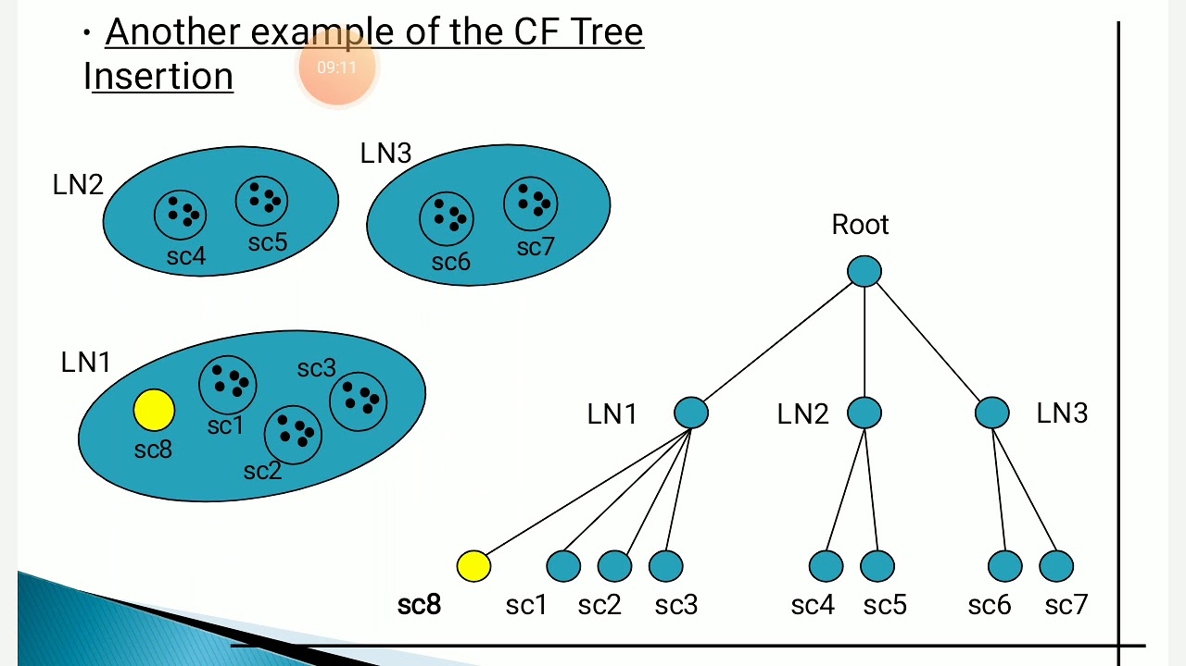
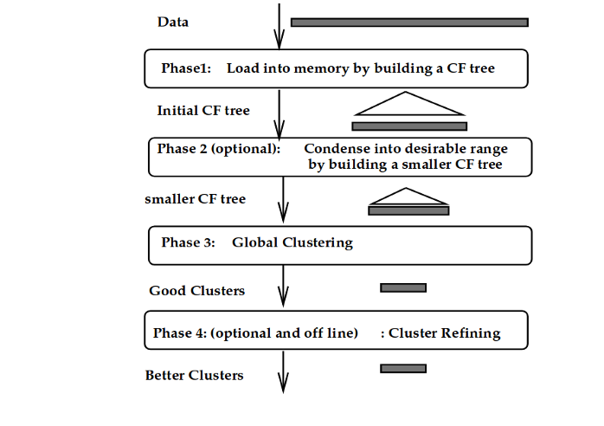

Slide 12
6.dbscan
In Density-based spatial clustering of applications with noise (DBSCAN) clustering method. Clusters are dense regions in the data space, separated by regions of the lower density of points. The DBSCAN algorithm is based on this intuitive notion of “clusters” and “noise”. The key idea is that for each point of a cluster, the neighborhood of a given radius has to contain at least a minimum number of points. Merits :
Partitioning methods (K-means, PAM clustering) and hierarchical clustering work for finding spherical-shaped clusters or convex clusters. They are suitable only for compact and well-separated clusters. Moreover, they are also severely affected by the presence of noise and outliers in the data.
Real-life data may contain irregularities, like: Clusters can be of arbitrary shape and Data may contain noise. Demerits:
High memory consumption
Struggles with cluster of similar density and high dimensional data.

Slide 13
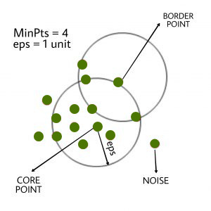
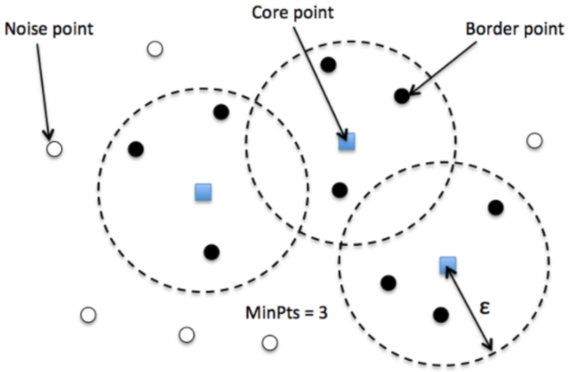
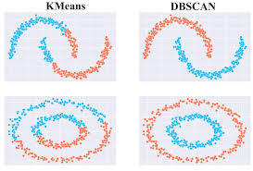

Slide 14
7.hdbscan
HDBSCAN is a clustering algorithm that is designed to uncover clusters in datasets based on the density distribution of data points. Unlike some other clustering methods, it doesn’t requires specifying the number of clusters in advance, making it more adaptable to different datasets. Merits :
It uses high-density regions to identify clusters and views isolated or low-density points as noise.
HDBSCAN is especially helpful for datasets with complex structures or varying densities because it creates a hierarchical tree of clusters that enable users to examine the data at different levels of granularity. Demerits:
Computationally expensive, parameter sensitivity.
Struggles with high dimensional data.

Slide 15
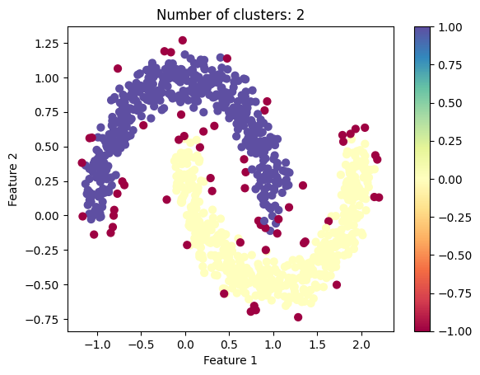
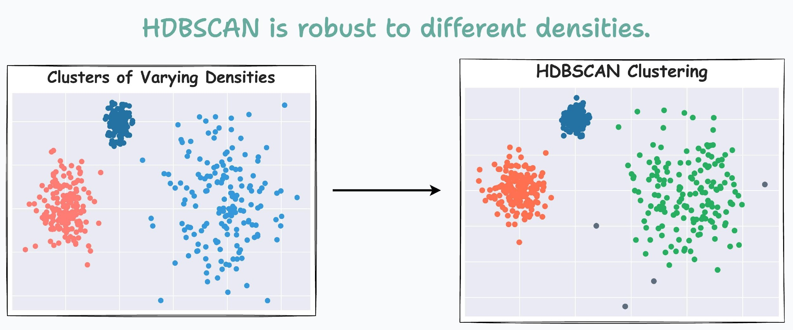

Slide 16
8.Optics
OPTICS Clustering stands for Ordering Points To Identify Cluster Structure. It draws inspiration from the DBSCAN clustering algorithm. It adds two more terms to the concepts of DBSCAN clustering.
The main idea behind OPTICS is to extract the clustering structure of a dataset by identifying the density-connected points. The algorithm builds a density-based representation of the data by creating an ordered list of points called the reachability plot. Each point in the list is associated with a reachability distance, which is a measure of how easy it is to reach that point from other points in the dataset. Points with similar reachability distances are likely to be in the same cluster. Merits :
OPTICS is a density-based clustering algorithm, but it can extract clusters of varying densities and shapes. It is useful for identifying clusters of different densities in large, high-dimensional datasets. Demerits :
It fails if there is no density drop between clusters.
Sensitive to parameters that define density.

Slide 17
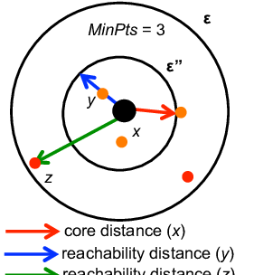
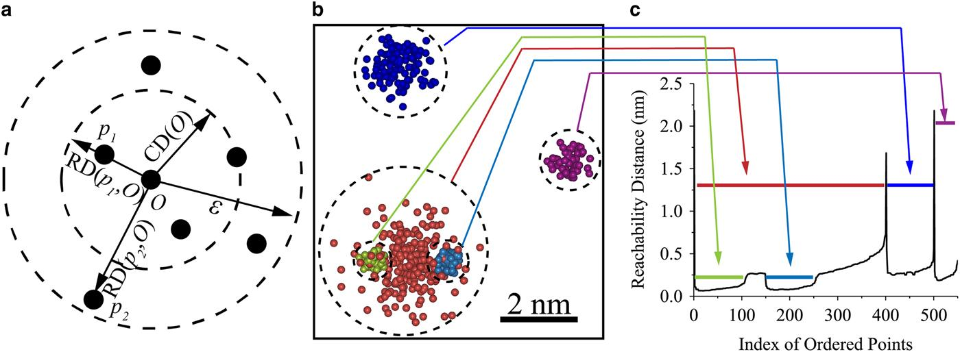

Slide 18
9. Spectral
In the clustering algorithm that we have studied before we used compactness(distance) between the data points as a characteristic to cluster our data points. However, we can also use connectivity between the data point as a feature to cluster our data points.
Spectral Clustering is a variant of the clustering algorithm that uses the connectivity between the data points to form the clustering. It uses eigenvalues and eigenvectors of the data matrix to forecast the data into lower dimensions space to cluster the data points. It is based on the idea of a graph representation of data where the data point are represented as nodes and the similarity between the data points are represented by an edge.
It uses eigenvectors of a similarity matrix to divide a set of data points into clusters. The basic idea behind spectral clustering is to use the eigenvectors of the Laplacian matrix of a graph to represent the data points and find clusters by applying k-means or another clustering algorithm to the eigenvectors. Merits:
It overcomes the limitations of centroid-based methods like K-means by using eigenvectors and connectivity measures
It offers a powerful solution for complex, non-convex cluster structures, Robust to noise and outliers. Demerits:
Computationally expensive.
Choosing the right number of clusters and the right similarity matrix can be challenging and may require expert knowledge or trial and error

Slide 19
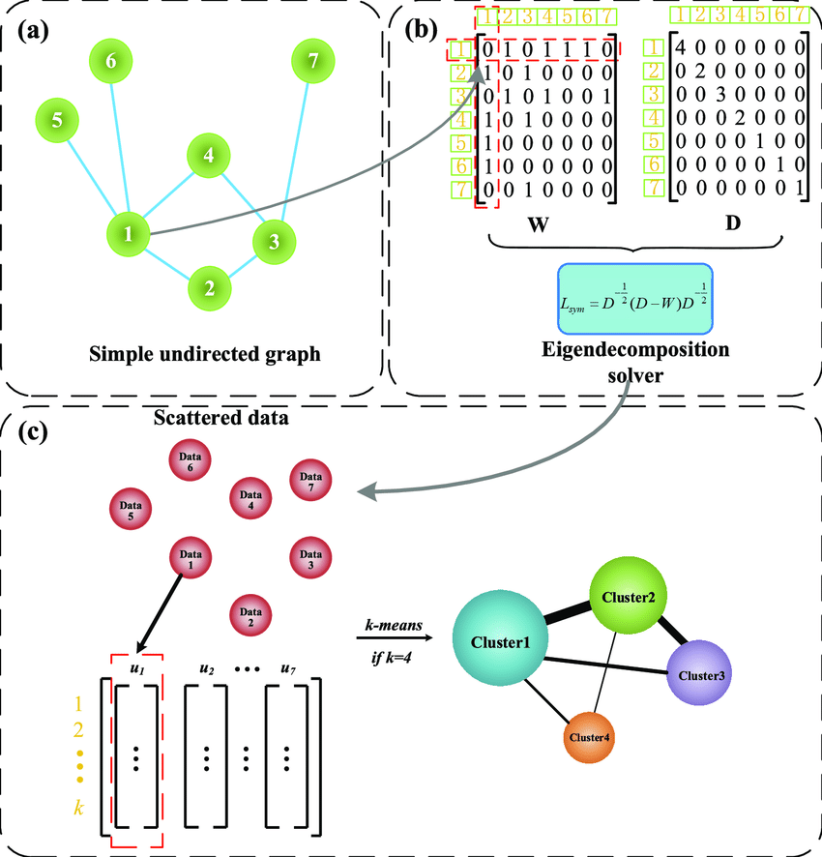

Slide 20
10. Affinity Propogation
Unlike other traditional algorithms which require specifying the number of clusters beforehand, Affinity Propagation discovers cluster centres and assigns data points to clusters autonomously. It is particularly useful when the number of clusters is not known in advance or when the data doesn’t conform to spherical or convex cluster shapes.
Affinity Propagation is based on the concept of “message-passing” between data points to identify cluster centres and assign data points to these centres automatically. It utilizes “exemplars,” which are typical data points representing other data points within the same cluster. The objective of the algorithm is to identify the most representative exemplars of the overall data and employ them to cluster the data into compatible groups. This algorithm is especially suitable for data with numerous clusters or data exhibiting intricate, non-linear distribution patterns. Merits :
Automatic Cluster Center Detection, Robust to Noise and Outliers, Handles Non-Spherical Clusters.
Scalability: It can be applied to large datasets, although it may require optimization for computational efficiency.

Slide 21
